Slide 1

DESTINY FREEDOM
Miracles happen every day.
33ppt
NEXT

Slide 2
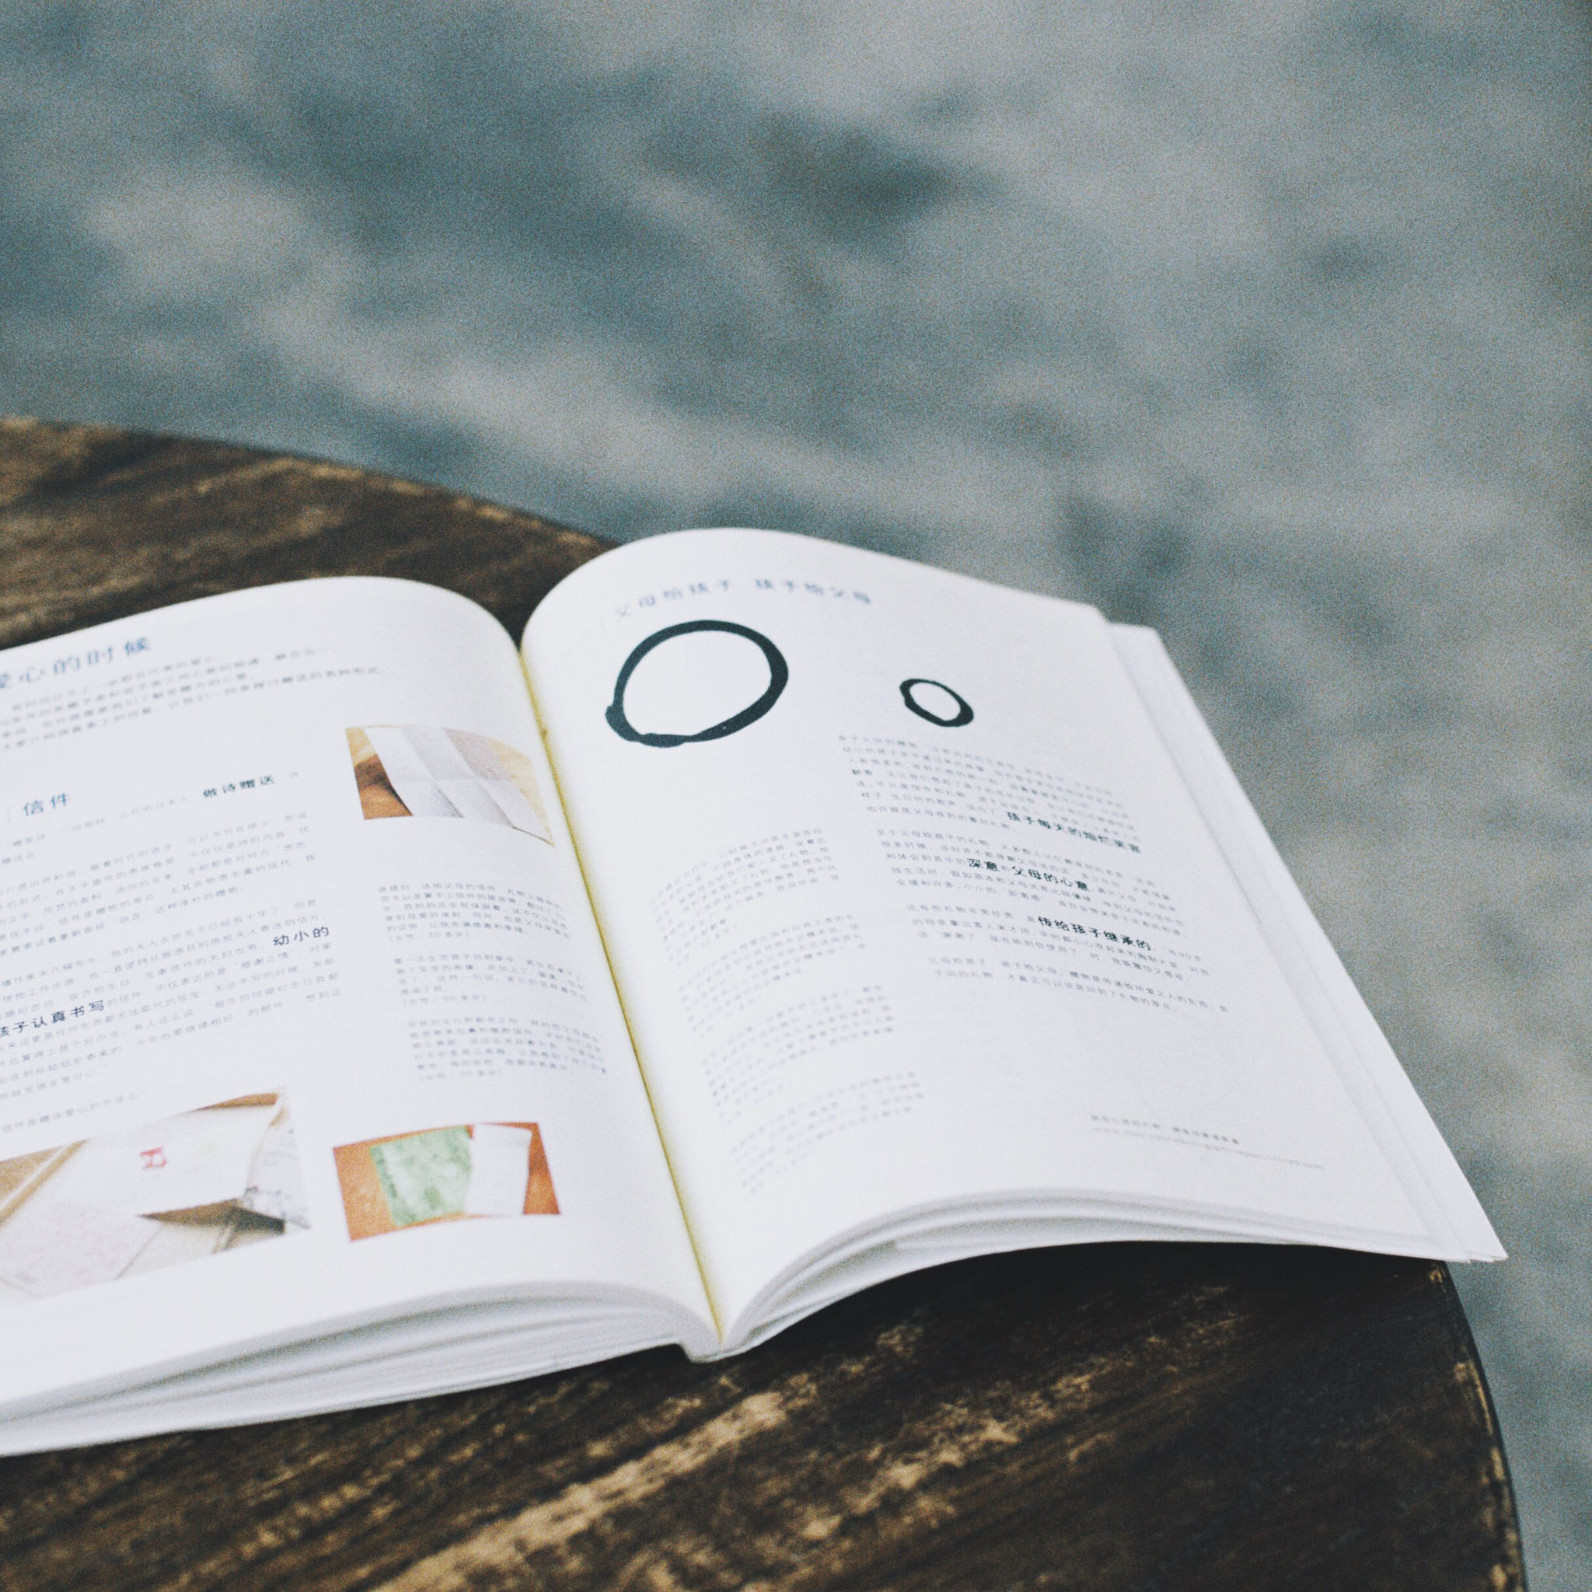
01
项目概述
02
主要特点
CONTENTS
03
成果展示
04
性能优化及扩展

Slide 3
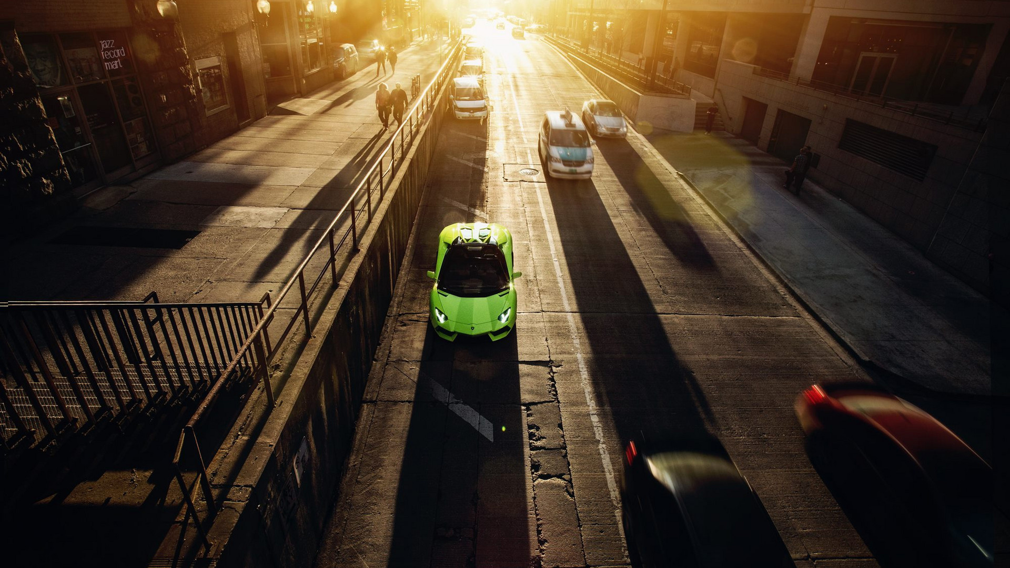
Part One
项目概述
I love you more than I've ever loved any woman. And I've waited longer for you than I've waited for any woman.

Slide 4

首先，对于本次项目，我们认为重点应该在“通用”二字。因此我们在设计中重点围绕“通用”来使本项目具有了非常高的兼容性和自定义性。而在功能方面，我们也同时考虑到了普通用户和开发者的视角，设计了许多能够给用户带来便利的功能。
No one indebted for others,while many people don't know how to cherish others.No one indebted for others,while many people don't know how to cherish others.

Slide 5
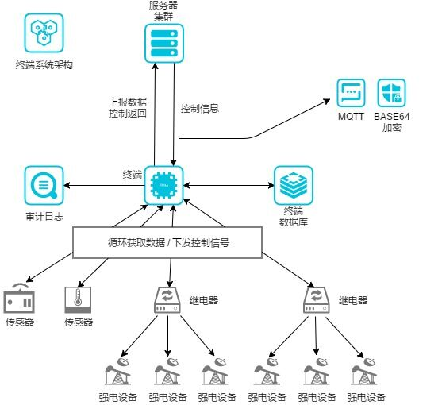
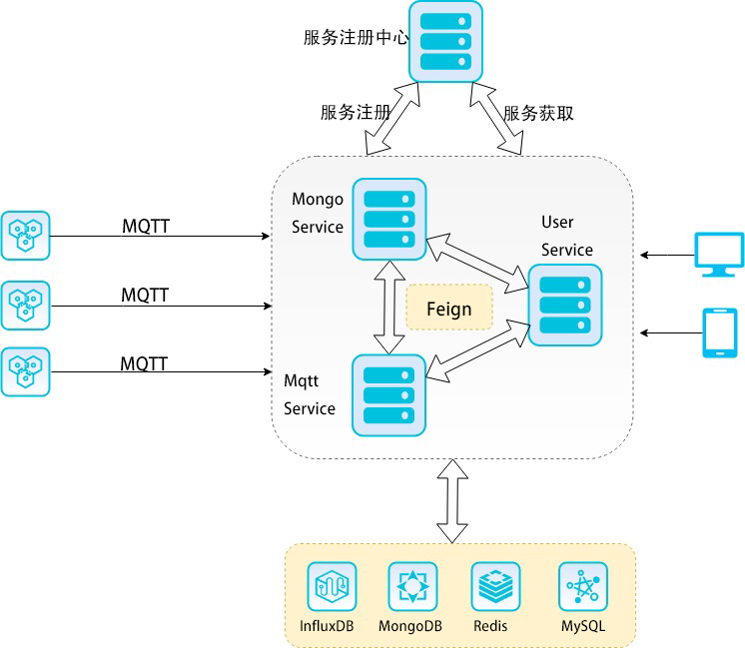
系统架构
Click here to add your title
I love you more than I've ever loved any woman. And I've waited longer for you than I've waited for any woman.

Slide 6

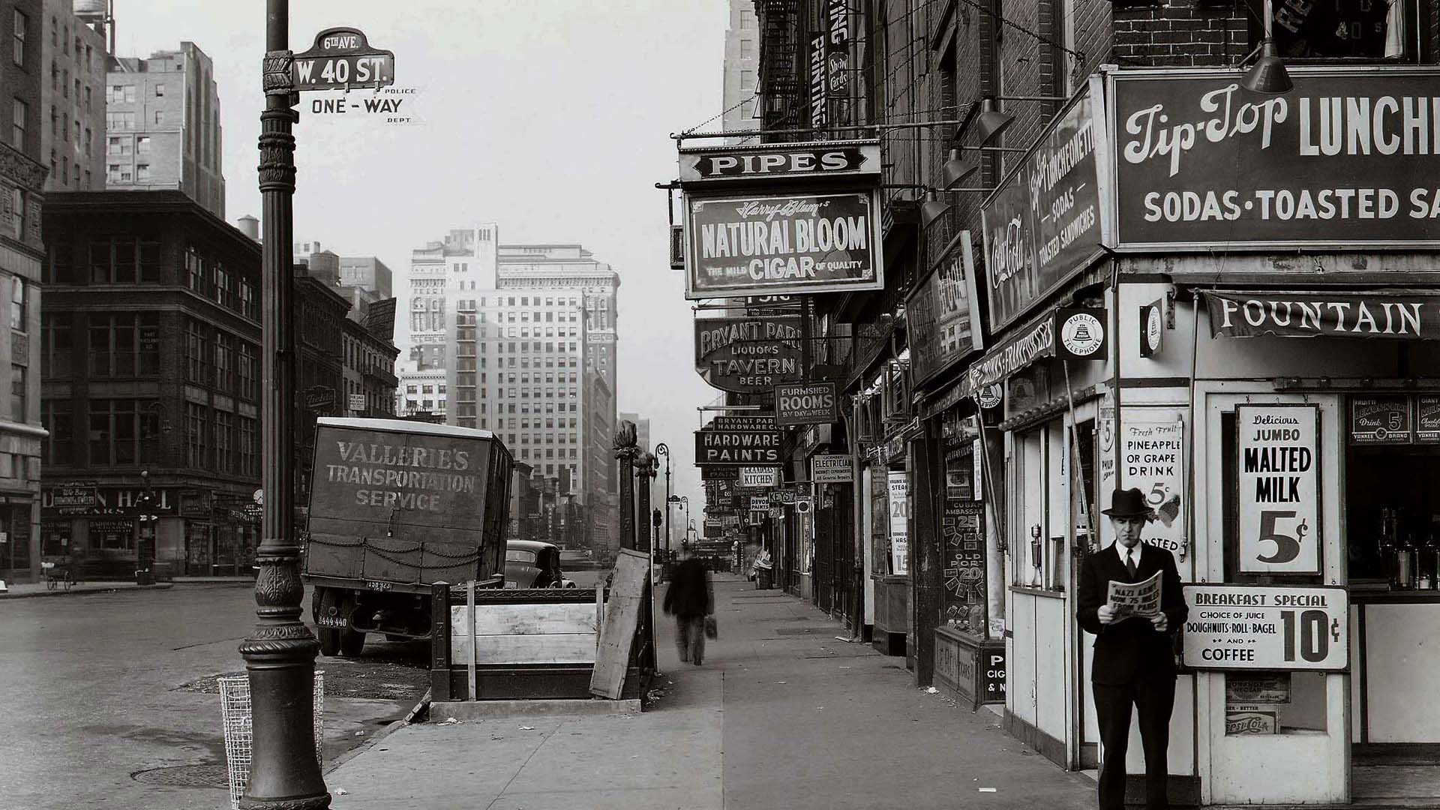

易于开发和维护
微服务架构
每个微服务都只关注某一部分的功能，比起将所有的功能都写在一起，微服务的代码会更清晰、更具可读性。
局部修改容易部署
在项目开发中，如果某个功能有问题，只需修改这台服务器的代码并重启即可，调试期间不会影响到其他服务器的使用。而在服务正式上线后，这样的特性也能使它在需要修改时最大程度的提供可用性。
技术栈不受限
可以使用多种不易相互兼容的编程语言或技术，比如本次项目中的mongodb和mysql，由于我们使用JPA来操作mysql，如果在同一个服务器程序中写入mongodb的数据源，会造成JPA的数据源混乱，导致无法使用，而使用微服务就能避免这样的问题。
按需伸缩
项目可以根据需求实现有针对性的扩展。本项目中MqttService服务器相对于其他服务器有更高的性能需求，于是我们分配了12核8G的计算机供它使用，而UserService服务器则使用了4核8G计算机。

Slide 7
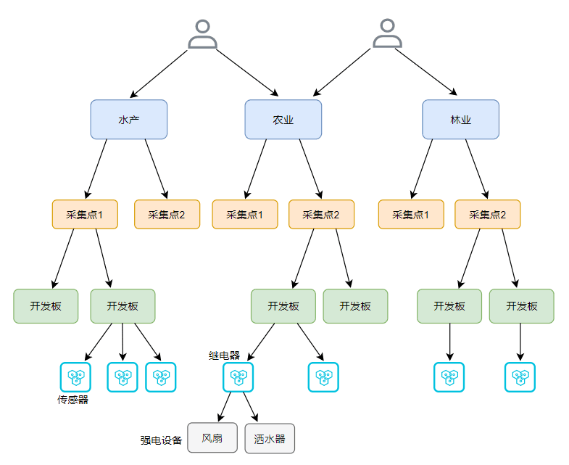
用户数据关系
Click here to add your title

Slide 8
Part One
主要特点
I love you more than I've ever loved any woman. And I've waited longer for you than I've waited for any woman.

Slide 9



主要特点
通用与兼容性
多协议支持、传感器适配
自定义性
自定义数据上报形式，动态修改发送间隔，自定义规则，自定义产业终端和传感器的信息。
稳定与安全性
终端读取传感器的锁保护，多源下行指令的精确返回，上下行数据加密

Slide 10

项目特性
自动数据上报、

Slide 11
Part One
成果展示
I love you more than I've ever loved any woman. And I've waited longer for you than I've waited for any woman.

Slide 12
Part Two
未来展望
I love you more than I've ever loved any woman. And I've waited longer for you than I've waited for any woman.

Slide 13
我们还会进步
复杂逻辑的规则解析
用户权限系统
Token安全访问机制

Slide 14
Click here to add your title
No one indebted for others,while many people don't know how to cherish others.No one indebted for others,while many people don't know how to cherish others.
No one indebted for others,while many people don't know how to cherish others.No one indebted for others,while many people don't know how to cherish others.
No one indebted for others,while many people don't know how to cherish others.No one indebted for others,while many people don't know how to cherish others.

Slide 15


No one indebted for others,while many people don't know how to cherish others.No one indebted for others,while many people don't know how to cherish others.
Click here to add your title
No one indebted for others,while many people don't know how to cherish others.No one indebted for others,while many people don't know how to cherish others.No one indebted for others,while many people don't know how to cherish others.No one indebted for others,while many people don't know how to cherish others.

Slide 16
Part Two
Click here to add your title
I love you more than I've ever loved any woman. And I've waited longer for you than I've waited for any woman.

Slide 17
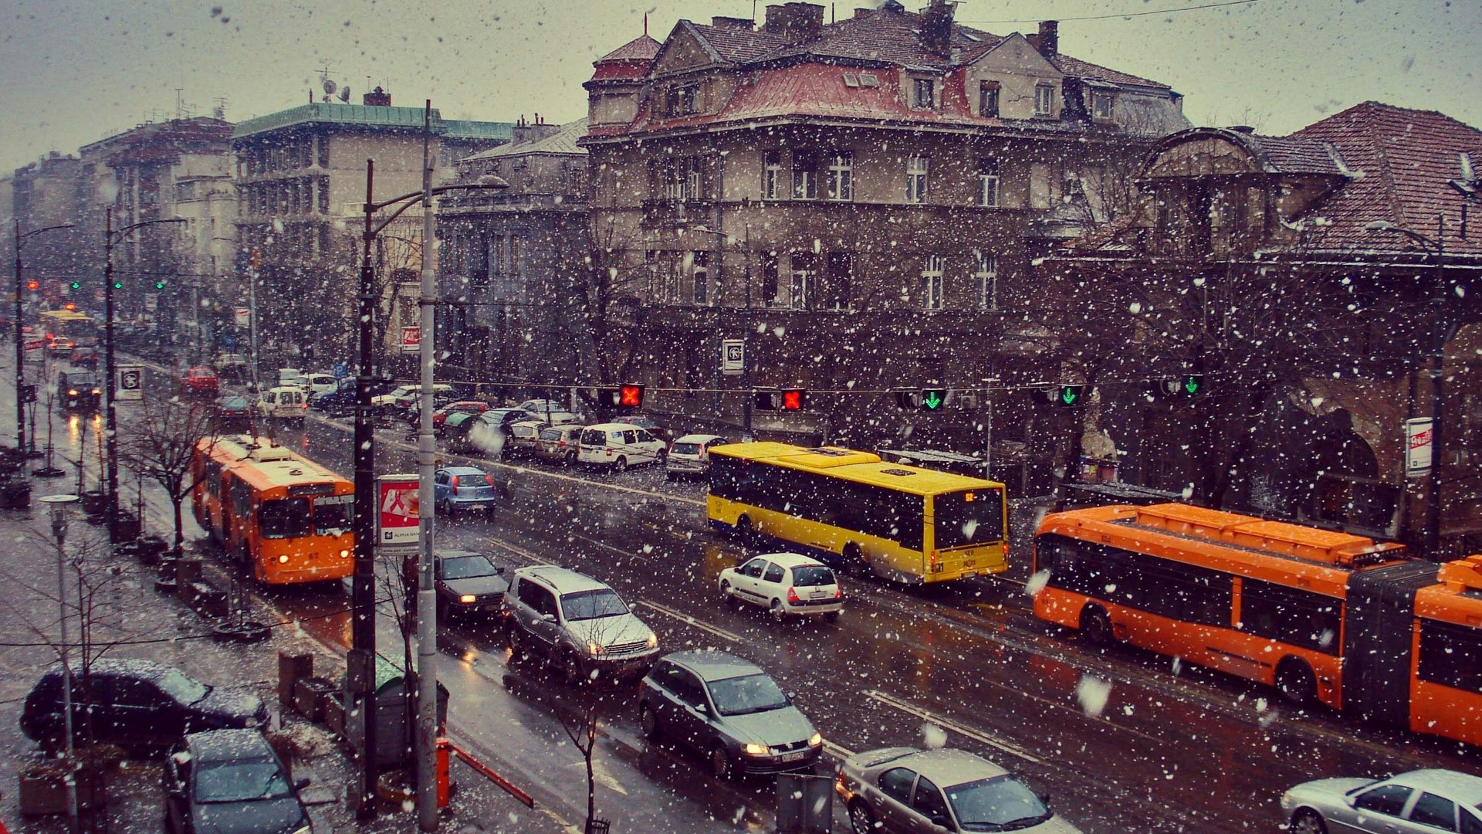
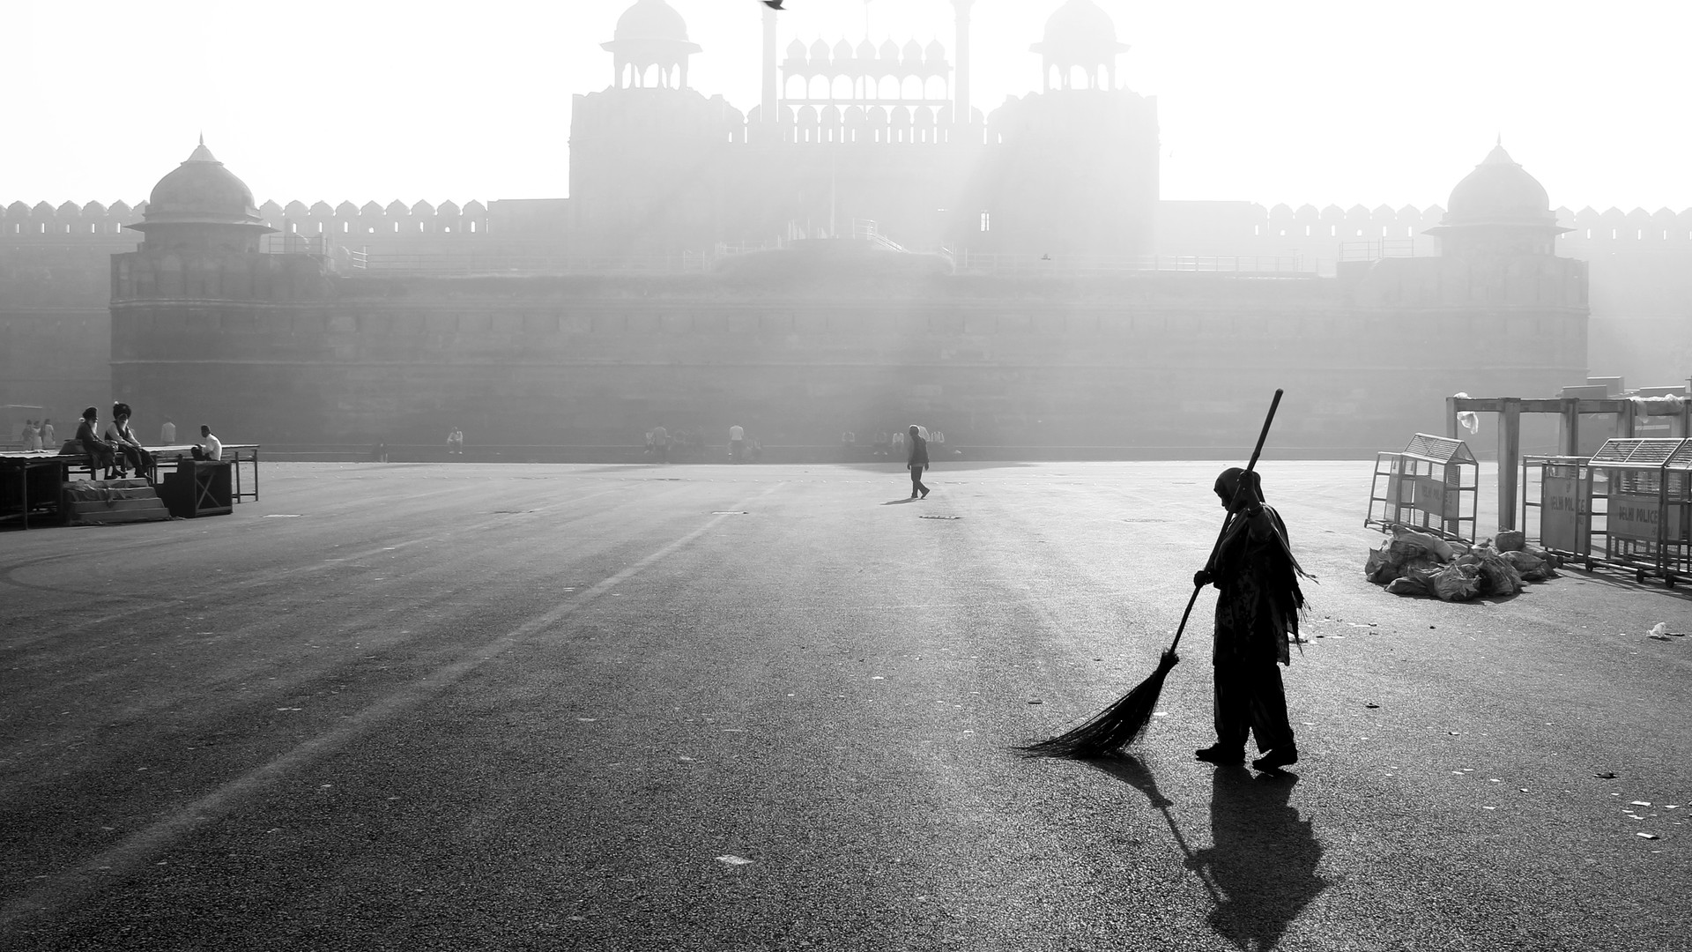
Click here to add your title
Click here to add your title
I love you more than I've ever loved any woman. And I've waited longer for you than I've waited for any woman.
I love you more than I've ever loved any woman. And I've waited longer for you than I've waited for any woman.

Slide 18
Click here to add your title
Click here to add your title
No one indebted for others,while many people don't know how to cherish others.No one indebted for others,while many people don't know how to cherish others.
Click here to add your title
No one indebted for others,while many people don't know how to cherish others.No one indebted for others,while many people don't know how to cherish others.
Click here to add your title
No one indebted for others,while many people don't know how to cherish others.No one indebted for others,while many people don't know how to cherish others.

Slide 19


Click here to add your title
Click here to add your title
No one indebted for others,while many people don't know how to cherish others.No one indebted for others,while many people don't know how to cherish others.

Slide 20
Click here to add your title
No one indebted for others,while many people don't know how to cherish others.No one indebted for others,while many people don't know how to cherish others.

Slide 21


Click here to add your title
Click here to add your title
No one indebted for others,while many people don't know how to cherish others.No one indebted for others,while many people don't know how to cherish others.
No one indebted for others,while many people don't know how to cherish others.No one indebted for others,while many people don't know how to cherish others.

Slide 22
Part Three
Click here to add your title
I love you more than I've ever loved any woman. And I've waited longer for you than I've waited for any woman.

Slide 23
Click here to add your title
No one indebted for others,while many people don't know how to cherish others.No one indebted for others,while many people don't know how to cherish others.
Click here to add your title
No one indebted for others,while many people don't know how to cherish others.No one indebted for others,while many people don't know how to cherish others.
Click here to add your title
No one indebted for others,while many people don't know how to cherish others.No one indebted for others,while many people don't know how to cherish others.
Click here
to add your title

Slide 24

Click here to add your title
I love you more than I've ever loved any woman. And I've waited longer for you than I've waited for any woman.
Click here to add your title
I love you more than I've ever loved any woman. And I've waited longer for you than I've waited for any woman.

Slide 25

Click here to add your title
No one indebted for others,while many people don't know how to cherish others.No one indebted for others,while many people don't know how to cherish others.
Click here to add your title
No one indebted for others,while many people don't know how to cherish others.No one indebted for others,while many people don't know how to cherish others.
Click here to add your title
No one indebted for others,while many people don't know how to cherish others.No one indebted for others,while many people don't know how to cherish others.

Slide 26
Click here to add your title
Click here to add your title
No one indebted for others,while many people don't know how to cherish others.No one indebted for others,while many people don't know how to cherish others.
No one indebted for others,while many people don't know how to cherish others.No one indebted for others,while many people don't know how to cherish others.
No one indebted for others,while many people don't know how to cherish others.No one indebted for others,while many people don't know how to cherish others.

Slide 27

ART
MON
OUR
Click here to add your title
I love you more than I've ever loved any woman. And I've waited longer for you than I've waited for any woman.

Slide 28
Part Four
Click here to add your title
I love you more than I've ever loved any woman. And I've waited longer for you than I've waited for any woman.

Slide 29
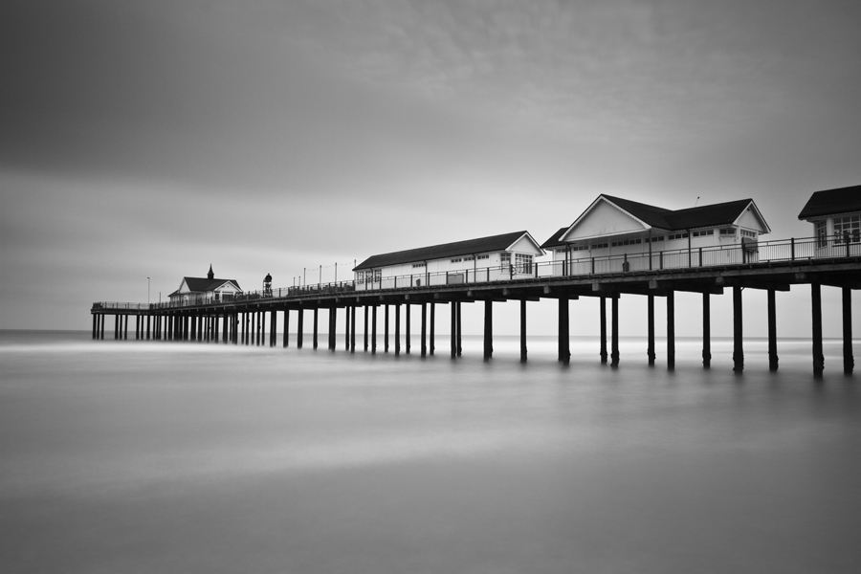
Click here to add your title
Click here to add your title
No one indebted for others,while many people don't know how to cherish others.No one indebted for others,while many people don't know how to cherish others.No one indebted for others,while many people don't know how to cherish others.No one indebted for others,while many people don't know how to cherish others.
Click here to add your title

Slide 30


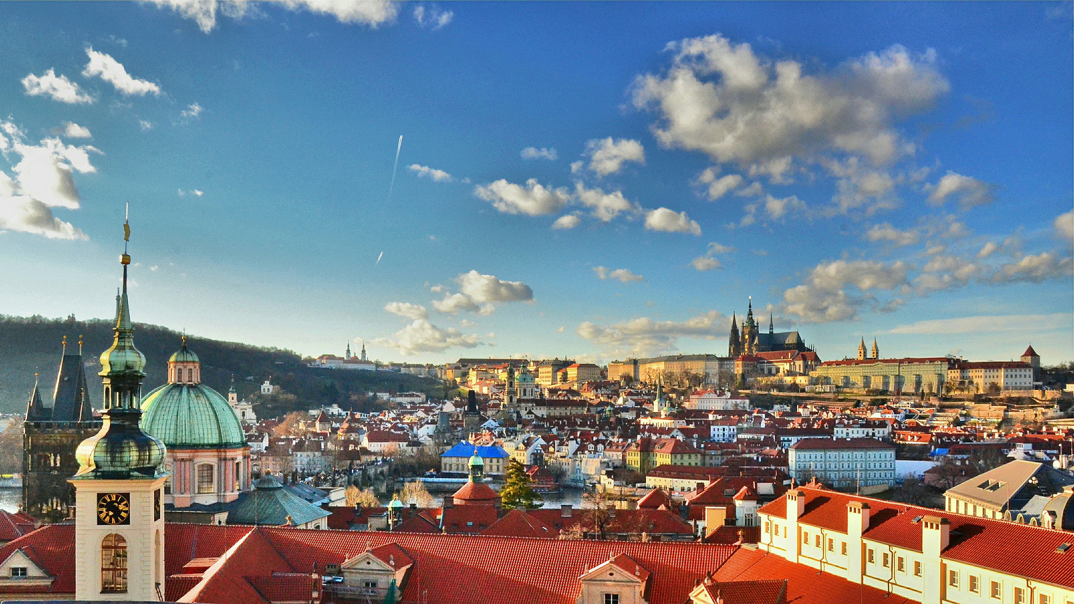
Click here to add your title
Click here to add your title
Click here to add your title
No one indebted for others,while many people don't know how to cherish others.No one indebted for others,while many people don't know how to cherish others.
No one indebted for others,while many people don't know how to cherish others.No one indebted for others,while many people don't know how to cherish others.
No one indebted for others,while many people don't know how to cherish others.No one indebted for others,while many people don't know how to cherish others.

Slide 31
Click here to add your title
No one indebted for others,while many people don't know how to cherish others.No one indebted for others,while many people don't know how to cherish others.No one indebted for others,while many people don't know how to cherish others.No one indebted for others,while many people don't know how to cherish others.

Slide 32
Click here to add your title
No one indebted for others,while many people don't know how to cherish others.No one indebted for others,while many people don't know how to cherish others.

Slide 33
Thank you for watching
Miracles happen every day.
Name of company
END

